Slide 1
CSS Classes
Tutorial #21

Slide 2
OBJECTIVE

Slide 3
Objective
By the end of this tutorial, you should have a good understanding of CSS classes and how they work.

Slide 4
TEXTPLANATION

Slide 5
Textplanation
Once you learn classes, you never have to use any other CSS selector ever again.

Slide 6
Textplanation
False.

Slide 7
Textplanation
Once you learn classes, you will severely limit the use of other selectors.

Slide 8
Textplanation
Yeah, that one’s kinda true.

Slide 9
Textplanation
The selector for a CSS class is the dot (.), which is the same selector you use in Javascript when accessing the properties and functions of objects. That’s not a coincidence, but we’ll talk about that another time.

Slide 10
Textplanation
Using classes, you can specifically design a group of tags, either the same tags or otherwise, to a kind of style. It’s a two step process that starts with the HTML and ends with the CSS.

Slide 11
Textplanation
In the HTML, choose your tag (or tags) and assign the class attribute.
<span class = “redtext”>This is red text</span>

Slide 12
Textplanation
Then, in the CSS, you assign the style properties.
span.redtext
{
color:red;
}

Slide 13
Textplanation
Now, only <span>s with the class attribute set to redtext will have the color red for their text. Of course, you can assign more than just the one property and you should definitely be more clever with your classnames.

Slide 14
Textplanation
You’re also not limited to single tags. If you have a group of <span>s and <div>s that share some style qualities, you can give them all the same class name and, in the CSS, just omit the tagname.
.sharedclass
{
Property:value;
}

Slide 15
Textplanation
Remember to lead with that dot(.).

Slide 16
Textplanation
As with other selectors, you can combine them to give yourself more flexibility. What if I wanted to create a style for only <span>s that are descendants of <div>s that are in the pappy class?
div.pappyclass span

Slide 17
Textplanation
Remember that designing the front end of a page can be at least as hard as programming the logic. Having it all planned out and organized ahead of time will make your life a whole lot easier when you start trying to code it.

Slide 18
CONSTRUCTION

Slide 19
Construction
Create a folder somewhere on your drive and label it Into the Woods.
Included with this tutorial is a .zip file called Tutorial 21 CSS Classes.zip. Extract the contents of this file into your new folder. It contains all of your images and the base HTML file that we will be using for the construction.
Create a file called woods.css. The construction will begin in this file, but you will also be editing the HTML file as you go. Watch for the changes.
As you go through the images of the construction, add to your code. You will see comments with explanations of what you are doing. Those comments will change with each slide.
Remember to test your code after each change. It’s the best way to understand exactly what those changes are doing to your page.

Slide 20
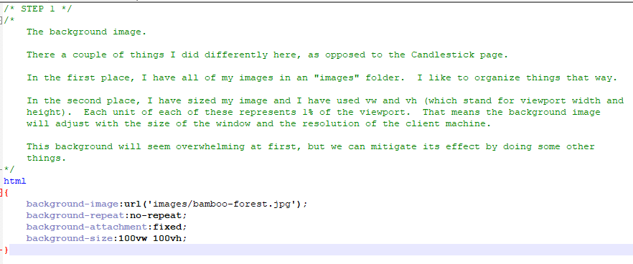
Construction

Slide 21
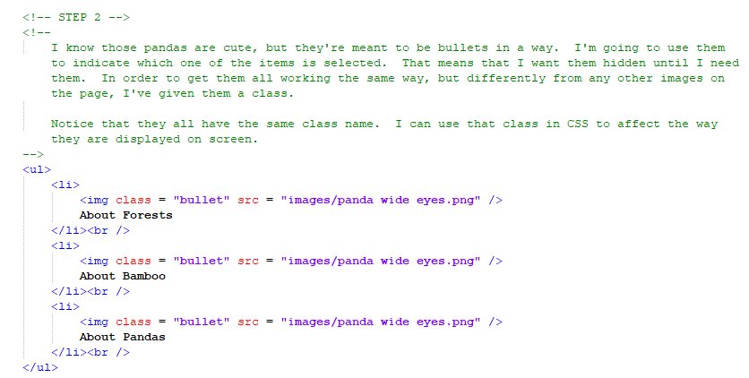
Construction

Slide 22
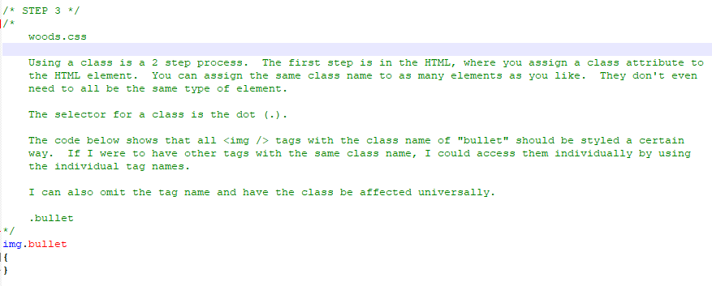
Construction

Slide 23
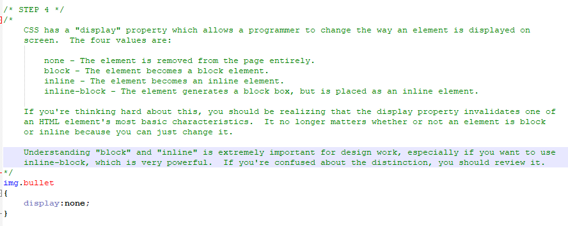
Construction

Slide 24
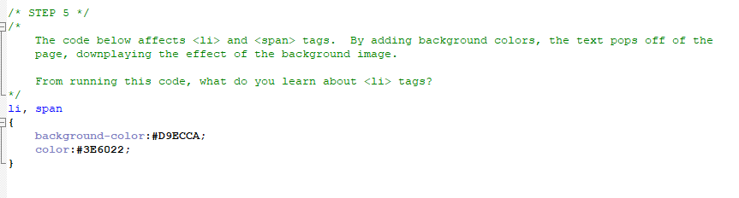
Construction

Slide 25
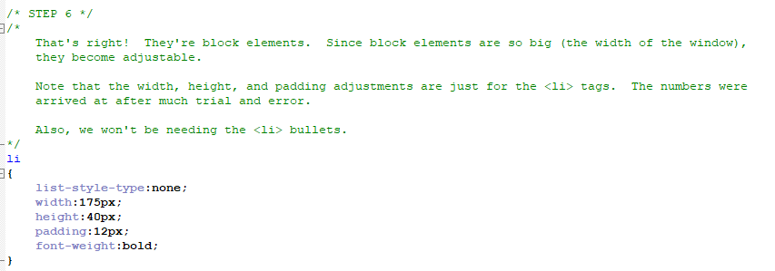
Construction

Slide 26
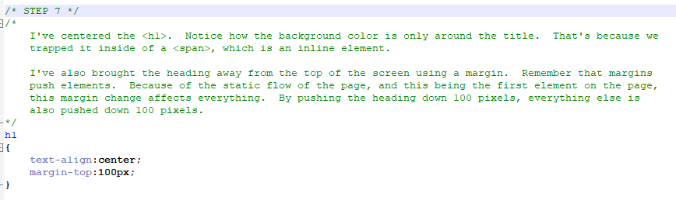
Construction

Slide 27
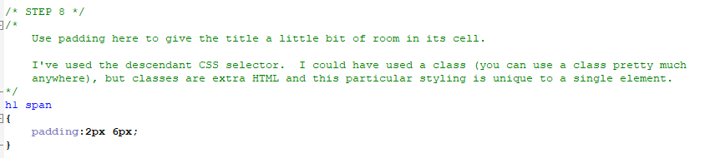
Construction

Slide 28
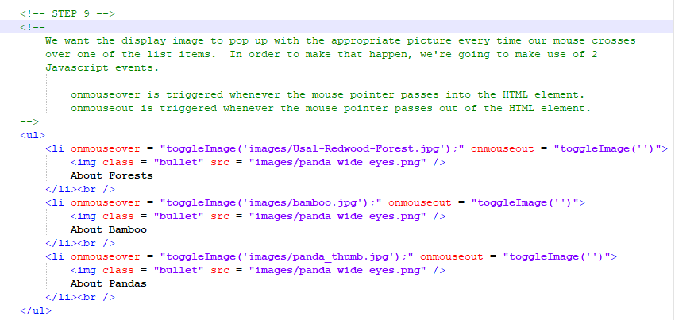
Construction

Slide 29
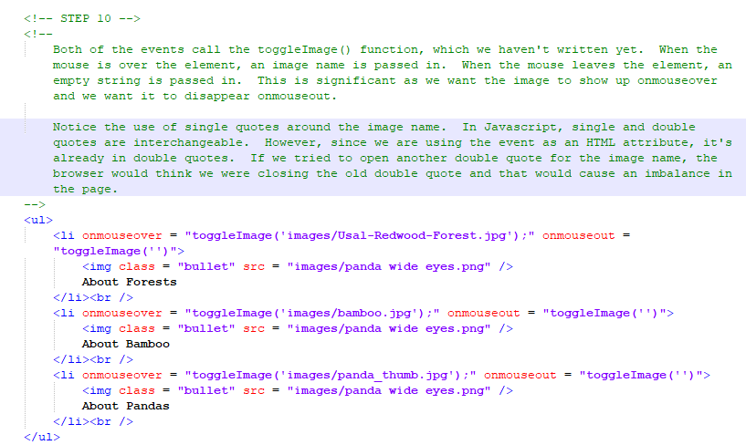
Construction

Slide 30
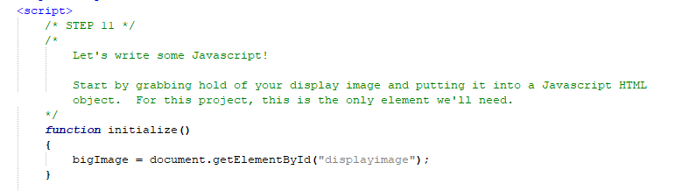
Construction

Slide 31
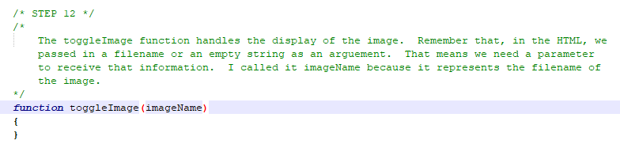
Construction

Slide 32
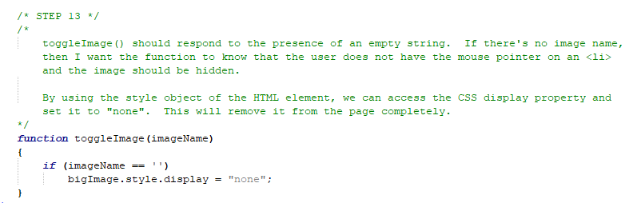
Construction

Slide 33
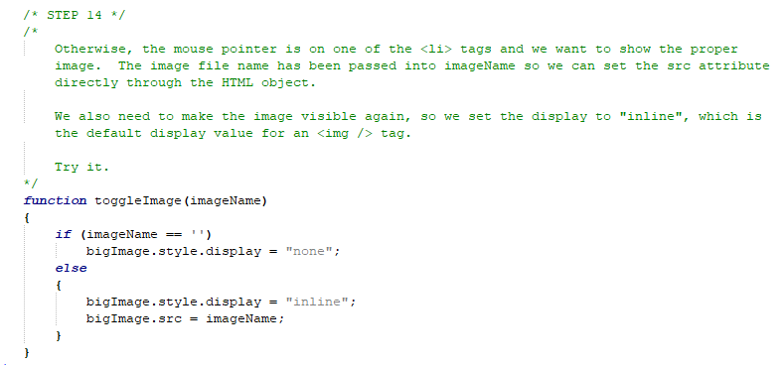
Construction

Slide 34
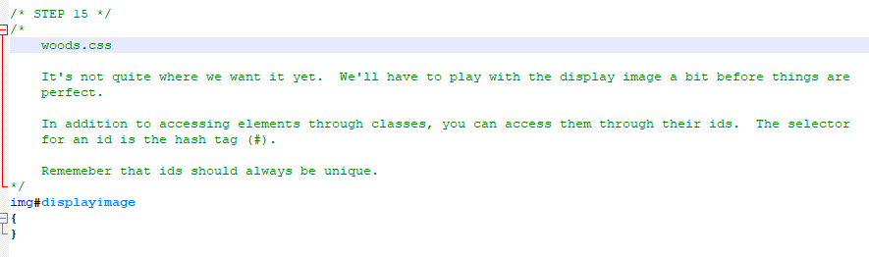
Construction

Slide 35
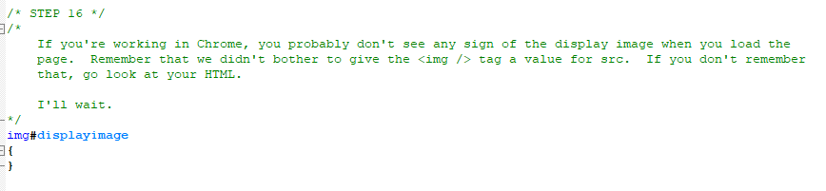
Construction

Slide 36
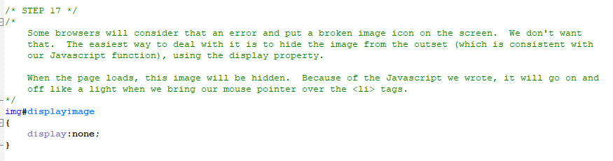
Construction

Slide 37
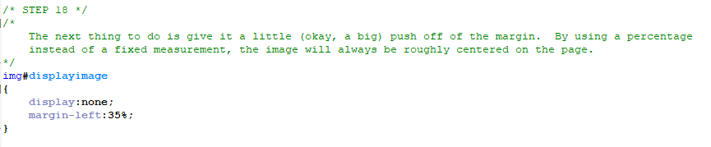
Construction

Slide 38
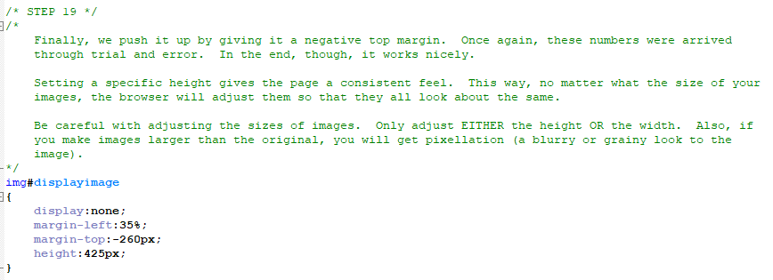
Construction

Slide 39
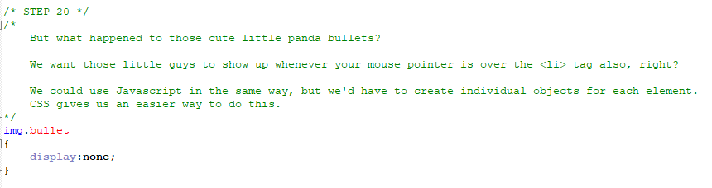
Construction

Slide 40
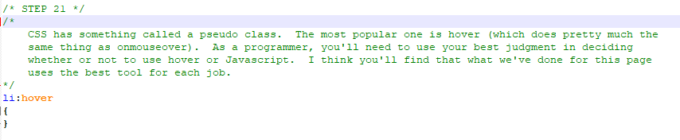
Construction

Slide 41
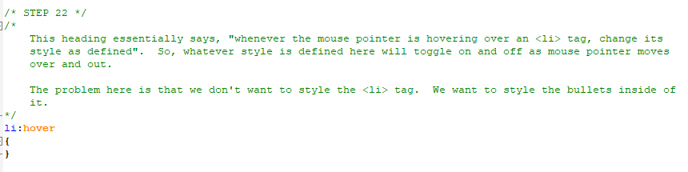
Construction

Slide 42
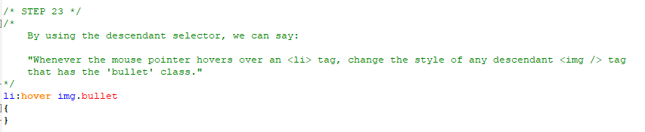
Construction

Slide 43
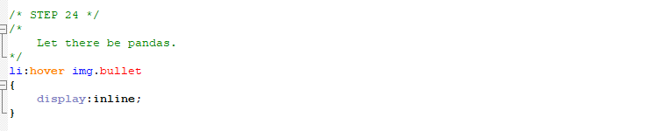
Construction

Slide 44
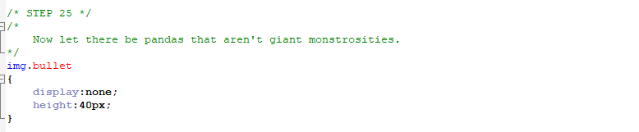
Construction

Slide 45
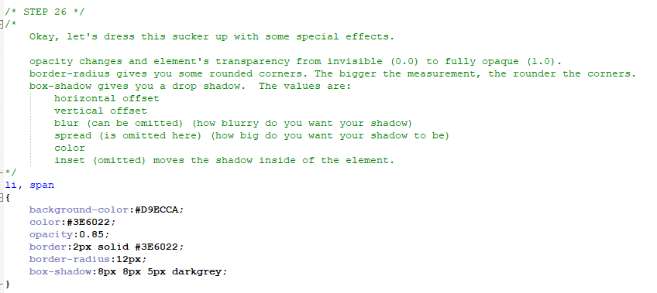
Construction

Slide 46
A DEEPER MEANING

Slide 47
A Deeper Meaning
The word “class” is short for “classification”. When designers started tooling around with object oriented programming, they started with something called structs, short for structures. These were pretty simple starter objects that held properties only (no functions). Functions were quickly added and structs gave way to classes. C++ has classes. Java has classes. Python has classes. Javascript kind of has classes, but they’re not explicitly defined.

Slide 48
A Deeper Meaning
When classes were designed for CSS, they were done so with this same idea in mind. Oh, you have that bunch of <span> tags and you want them all to have red text? Let’s make a class of <span> tags and redefine them.

Slide 49
A Deeper Meaning
As you begin to work in applications languages, you’re going to encounter classes, and objects made from them. Think about an HTML element. There are things they all share and, therefore, fall under the classification HTML Element. But there are things they don’t share and, therefore, each becomes its own object.

Slide 50
A Deeper Meaning
A lot of people have used CSS pseudo classes to implement functionality on their pages. If you search online, you'll find a cool way to use CSS pseudo classes to make drop down menus for your page. I don't recommend it. Juggling the selectors and the classes and the elements can end up being more trouble than it's worth. Use Javascript. Javascript has 2 events, like onclick, that do the same thing as hover.
onmouseover reacts to the mouse pointer passing over an element.
onmouseout reacts to the mouse pointer passing away from an element.

Slide 51
A Deeper Meaning
Using Javascript gives you way more control over your elements and I strongly recommend using it over CSS for advanced functionality. If you want something to highlight nicely for the user, hover is the way to go. Otherwise, stick with Javascript.

Slide 52
A Deeper Meaning
All of this boils down to organization of code. There’s a hierarchy built in to what you’re using here. Be aware of it. Make friends with it. Master it.

Slide 53
FAQ

Slide 54
FAQ
With classes, why do I need any other CSS selectors?
Classes are, by far, the most powerful and useful of the CSS selectors, however that doesn't mean you should just discount the existence of the others. If your page design conforms to a pattern that works with another selector, you may find it easier and more efficient to work that way. As with everything else in computer programming, you do what works best for your project.

Slide 55
FAQ
Why use Javascript to toggle the big image instead of hover?
CSS pseudo classes are great. In order to use them, though, you need to have your elements specifically related to one another. This can create problems when you’re trying to get two unrelated elements to react to one another. As an experienced programmer, you’ll use your judgment as to when to use Javascript and when to use hover.

Slide 56
ACTIVITY

Slide 57
Smiley Face
Included with this tutorial is a .zip file called Smiley Face.zip. It includes an HTML file and a spec sheet for the activity.
Read the spec sheet and remember:
The only changes you may make to the HTML is to add classes where you think necessary.

